Slide 1
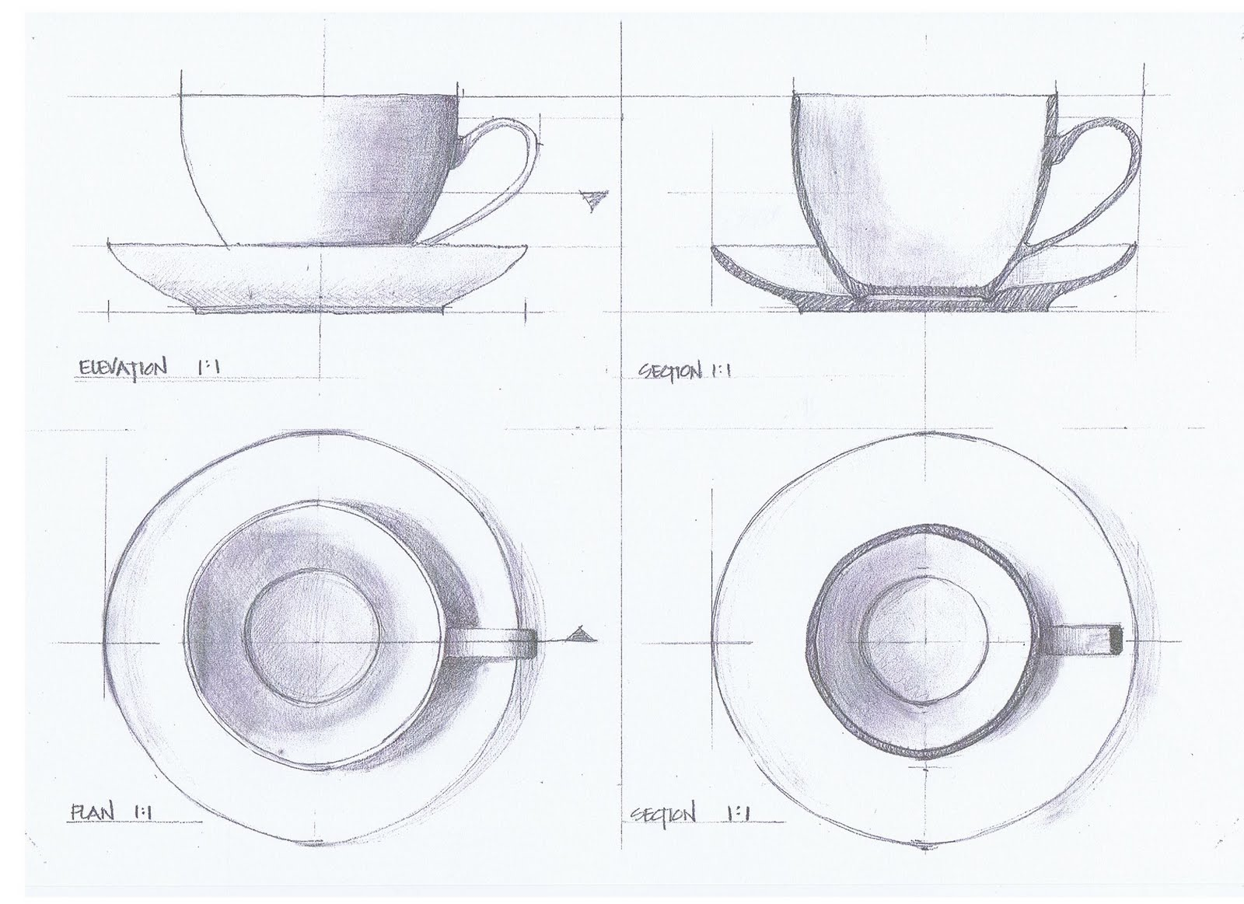
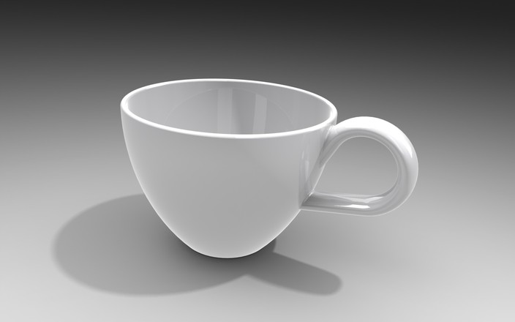
Drafting and Design
What is it?

Slide 2
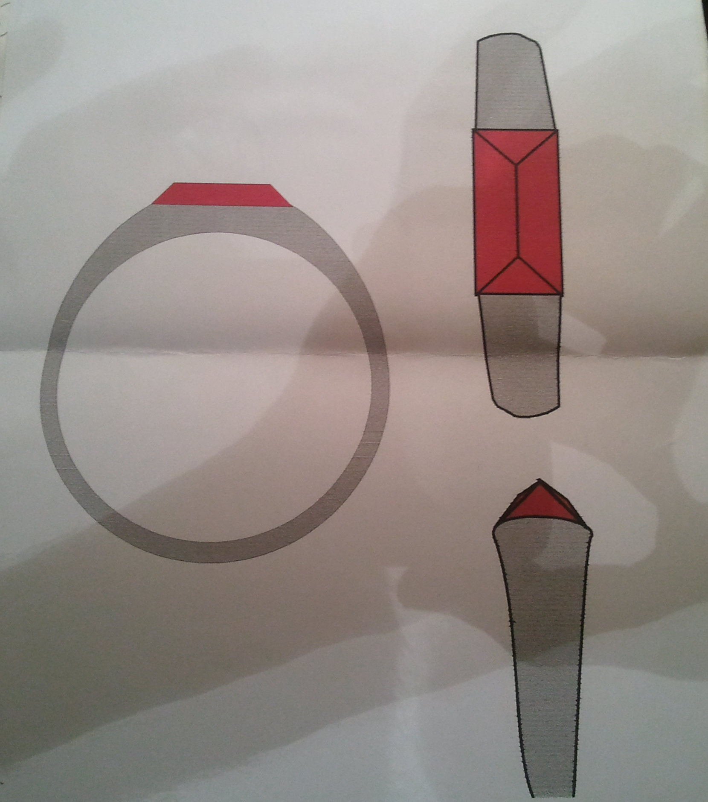
Design
Creative problem solving which begins with a specific human need and results in a product or solution that addresses that need.

Slide 3
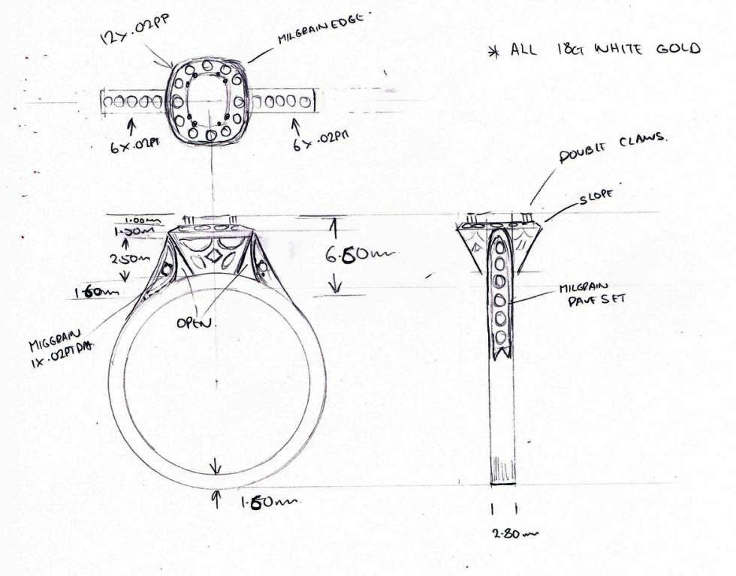

Slide 4
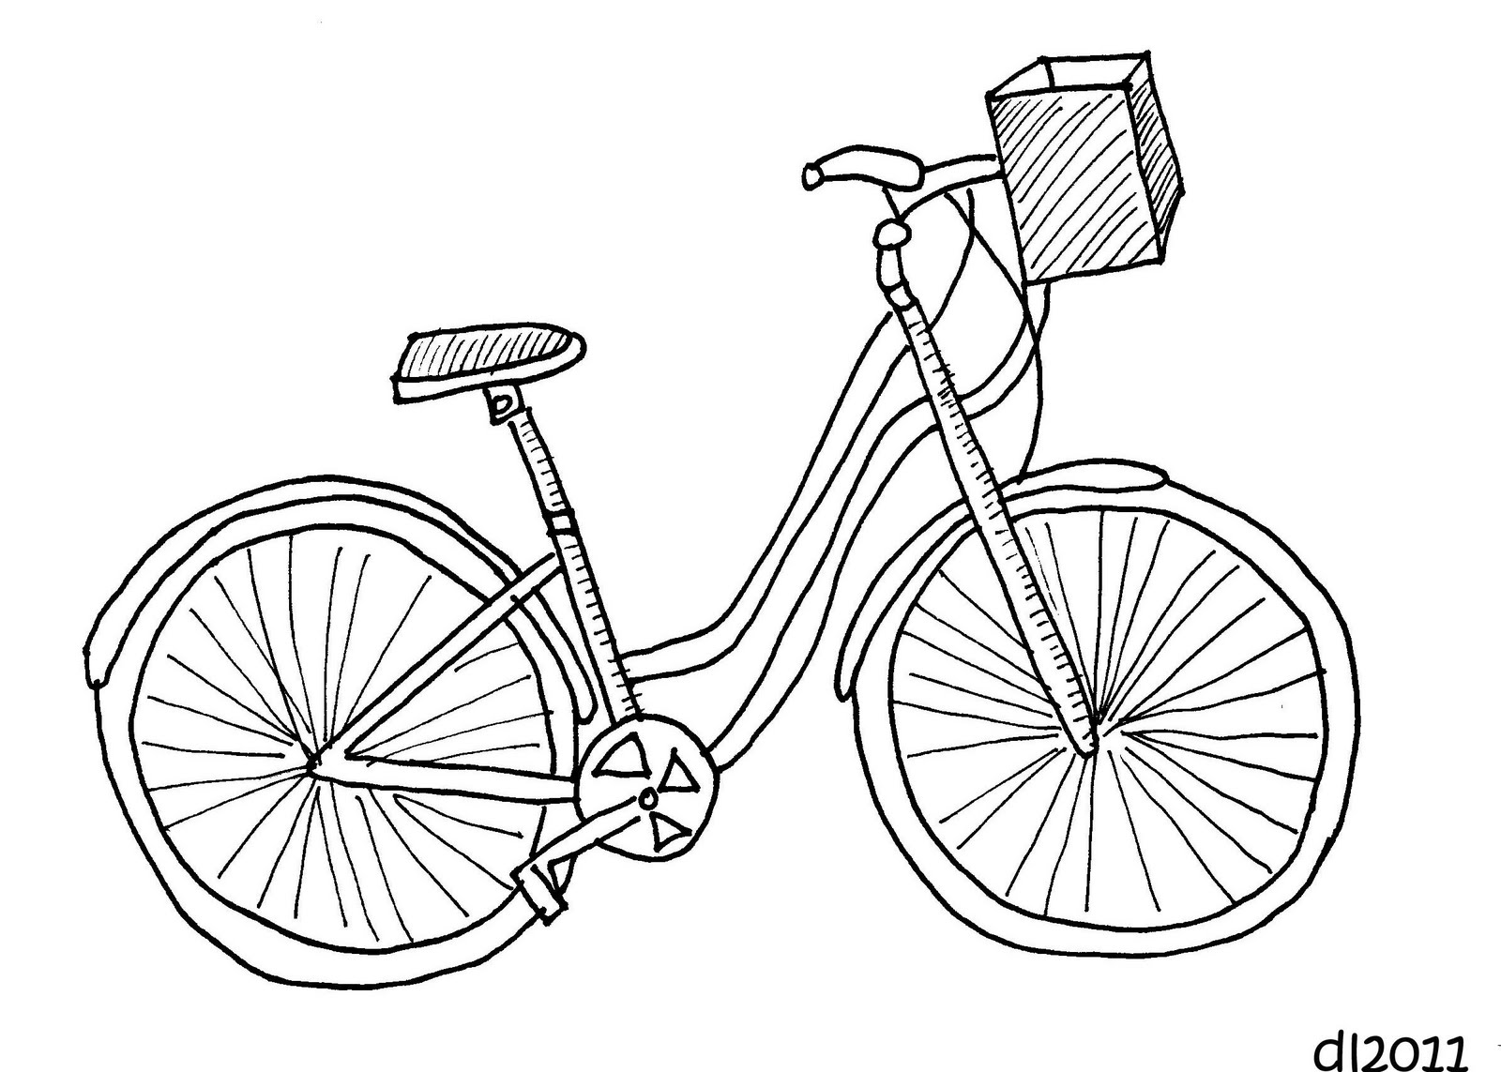
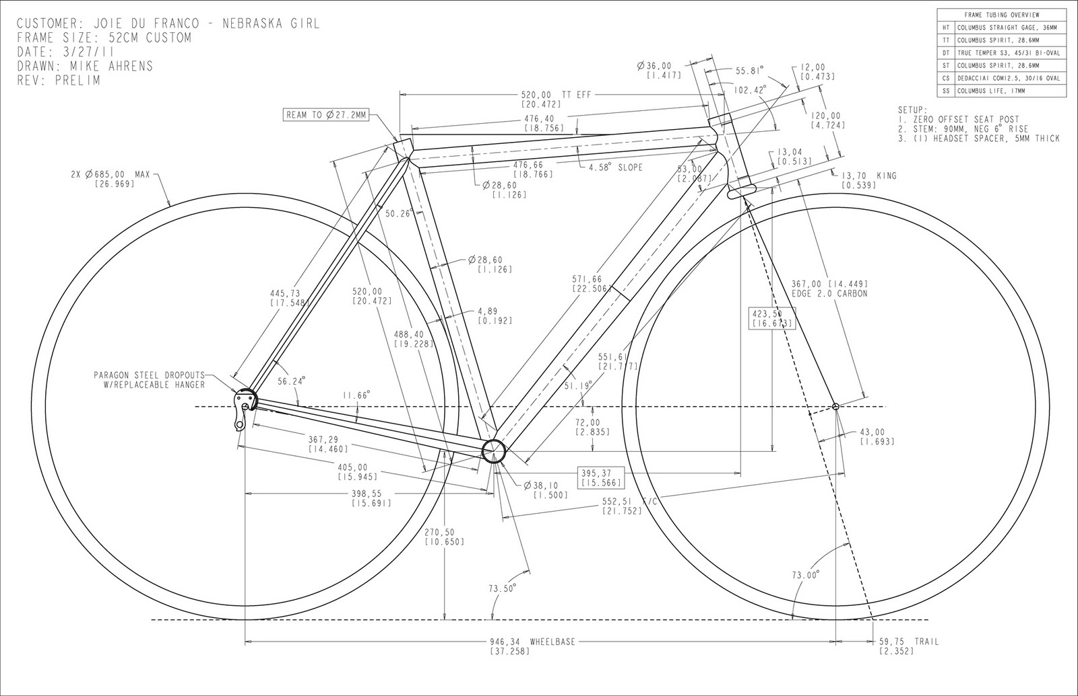
Drafting
Set of skills that allows the designer to communicate ideas and design solutions to others through technical drawings.

Slide 6
