Slide 1
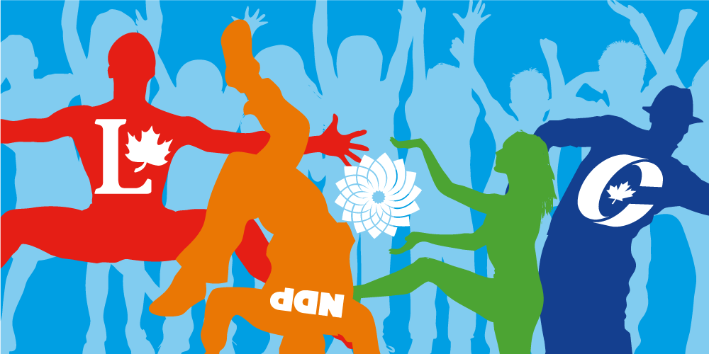
Government and Politics in Canada

Slide 2

Why Do We Need Government?
A country without government or a set of rules would become a state of Anarchy
Could Anarchy work?
If not then why?
  Survival
  Security
  Work together (collectively) or protect the individual?

Slide 3
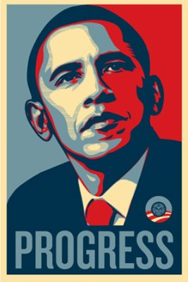
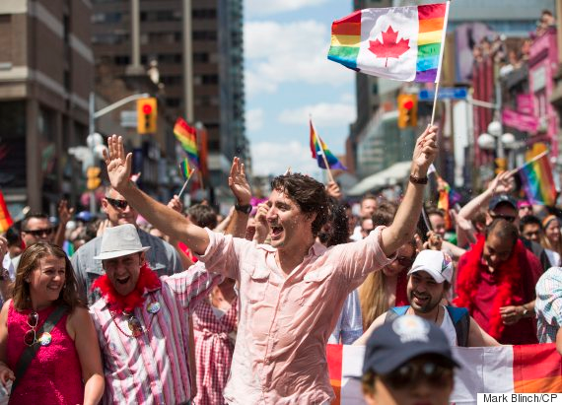
What is politics?
The attempt of individuals and groups to protect their security.
To further one’s interests
Do you engage in politics?

Slide 4
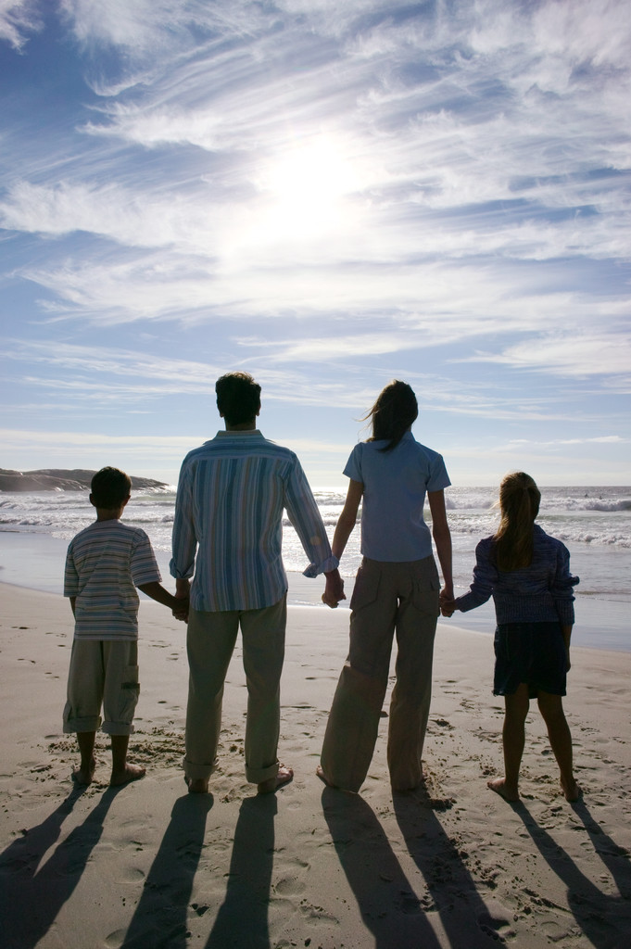
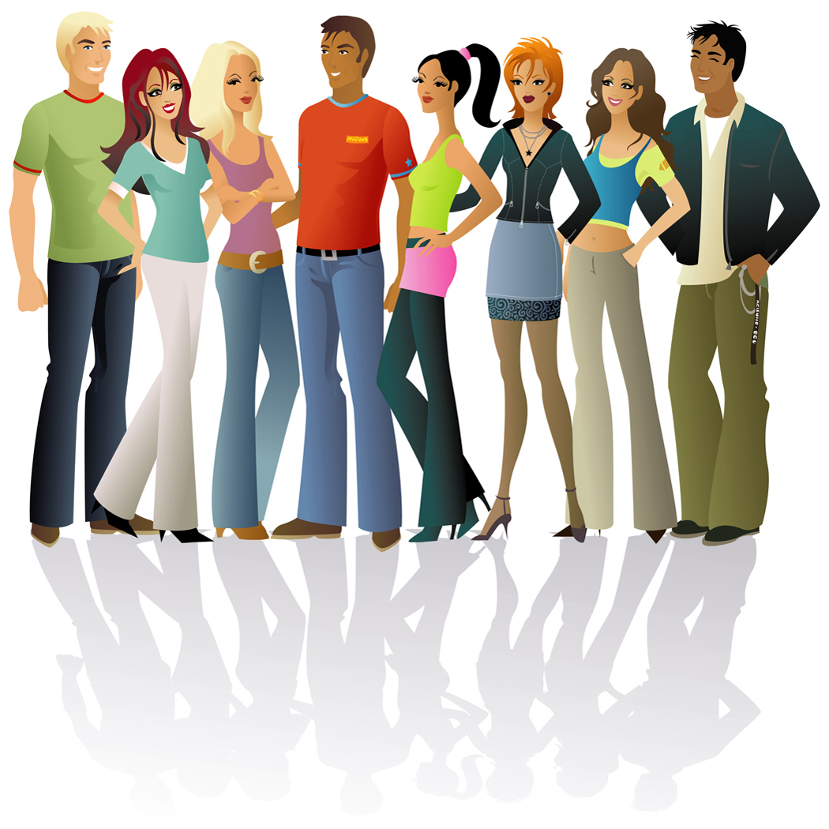
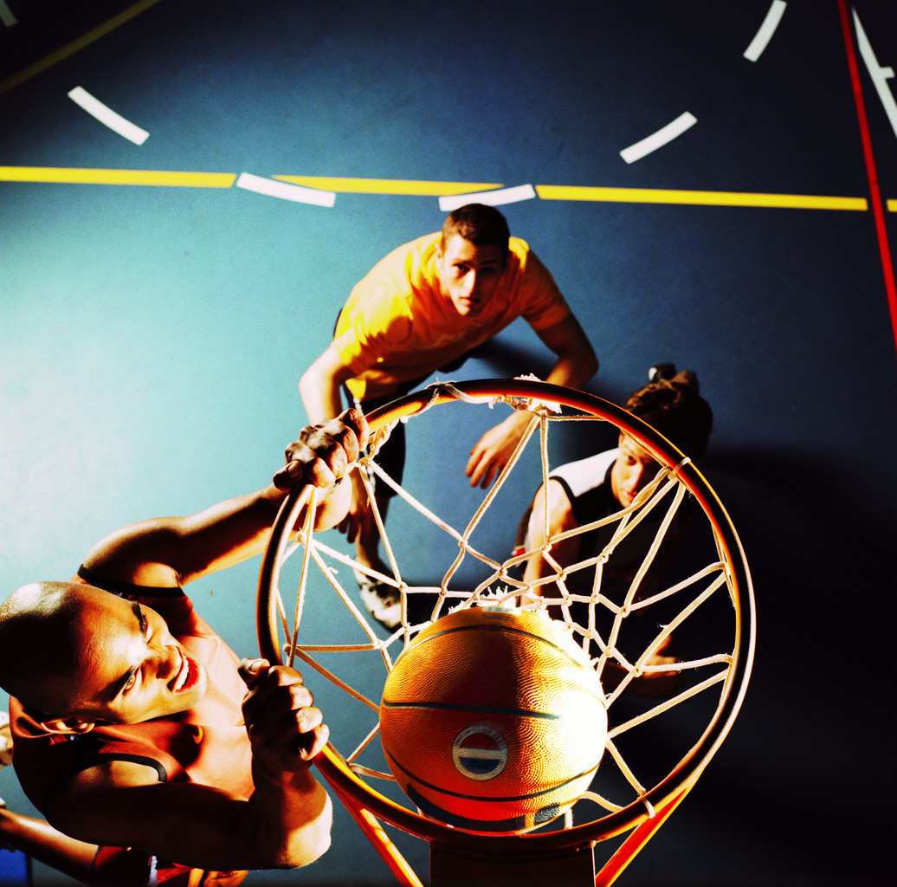
Family
School
Groups

Slide 5
Why do we need politics?
Cavemen and cavewomen only really concerned themselves with:
Survival
Family

Slide 6
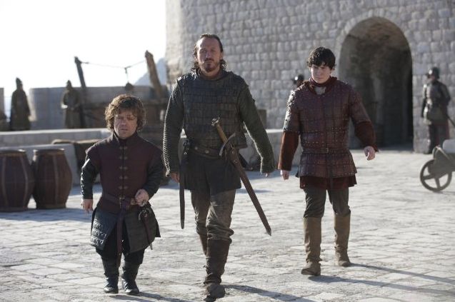
Families:
Traditionally were organized to protect security: Kinship
Humans can achieve this in groups
Creation of cities changed this security

Slide 7
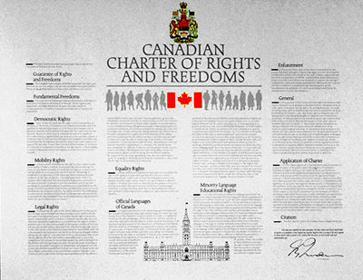
Groups of people coming together to live requires a level of order.
Security is threatened.
Results in need for social structure and organisation: RULES!!!!

Slide 8
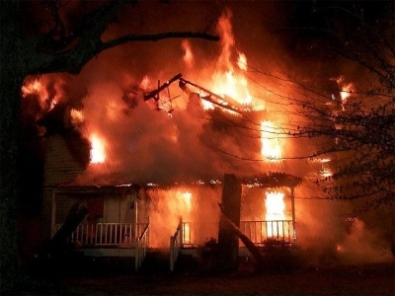
Human Nature
Nature vs. Nurture
Good or bad
Good or bad
Test Yourself:
Scenario- Next door house is on fire…What do you do?

Slide 9


Why is this important?
Vs.
Organizing a group
Self-governing

